Slide 1
Construction of Minimum Spanning Tree using Kruskal’s and Prim’s Algorithms
Vivek arvind balaji (1001108300)
Eshwar ravindran (1001120227)

Slide 2
CONTENTS
Objectives
Minimal Spanning Tree
Kruskal’s Algorithm
Implementation
Analysis
Prim’s Algorithm
Implementation
Analysis
Performance Comparison
Conclusion

Slide 3
OBJECTIVES
To implement Kruskal’s and Prim’s Algorithms for construction of Minimum Spanning Trees (MST),
Test the algorithms on data of different sizes,
Analyze the performances of both the algorithms.

Slide 4
MINIMUM SPANNING TREE (MST)
In graph theory, a spanning tree T of an undirected graph G is a sub-graph that includes all of the vertices of G, that is a tree.
A graph may have several spanning trees.
A minimum spanning tree is a spanning tree of a connected, undirected graph which connects all the vertices together with the minimal total weighting for its edges.

Slide 5
KRUSKAL’S ALGORITHM
To construct an MST for a given connected graph.
Implementation can be done using three methods:
Naïve method using DFS.
Union Find without Path Compression and union by rank heuristic.
Union Find with Path Compression and union by rank heuristic.
We use the second method, i.e., Union Find without Path Compression, since the naïve method using DFS is error prone for large data.

Slide 6
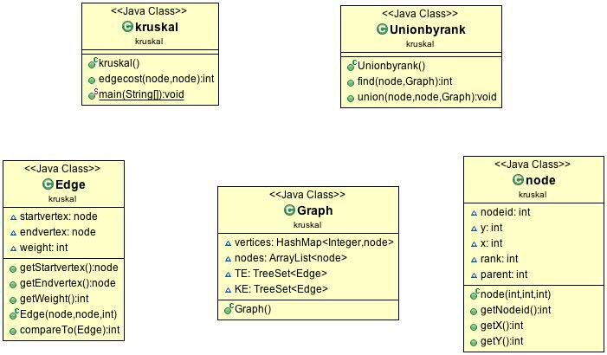
Implementation
Different data sizes varying in terms of number of nodes between 50 to 400.

Slide 7
ANALYSIS

Slide 8
PRIM’S ALGORITHM
To compute MST for a given connected graph.
Effective than Kruskal’s Algorithm.
Implementation using three techniques:
Storing edges as an unsorted array,
Storing edges as a sorted array,
Storing edges as minimum heap.
We use the third method, storing edges as minimum heap since it is the most effective one.

Slide 9
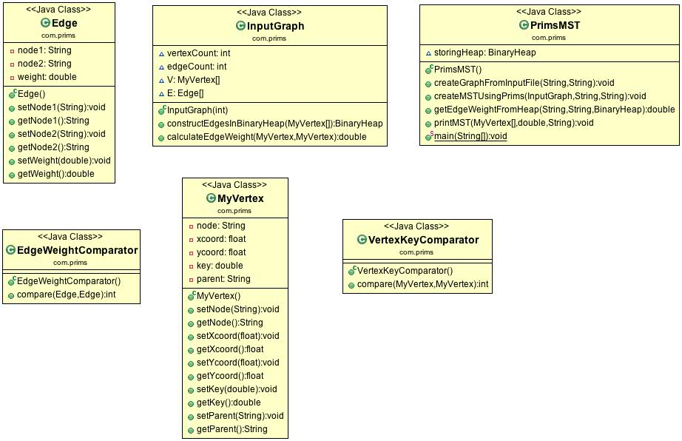
IMPLEMENTATION
Different data sizes varying in terms of number of nodes between 50 to 400.

Slide 10
ANALYSIS

Slide 11
PERFORMANCE COMPARISON
For a graph with V vertices and E edges,
Kruskal’s Algorithm runs in O (E log E) time.
Prim’s Algorithm runs in O (E log V) time.
Prim’s Algorithm runs significantly faster in dense graphs while Kruskal’s Algorithm performs better in sparse graphs.
Observations from graphs:
For our data, Kruskal’s Algorithm performs better in most of the cases.
Prim’s curve gets towards a dip when the number of nodes comes closer to 400.
Therefore, Prim’s Algorithm performs better for denser graphs.

Slide 12
CONCLUSION
Prim’s Algorithm performs better for real world data.
Example: Facebook graph search.
Contributions:
Eshwar Ravindran – Kruskal’s Algorithm.
Vivek Arvind Balaji – Prim’s Algorithm.

Slide 13

THANK YOU

